Slide 1
Knockout.js
Dynamic Web UIs and the MVVM pattern
Your name
Your company
@YourTwitterHandle
http://yourwebsite/

Slide 2






Knockout.js
MVVM for HTML and JavaScript
Open source JavaScript library (MIT license – source on GitHub)
~ 1 year old; active community
Community project (not run by Microsoft)

Slide 3





Knockout.js
What is it good for?
Rich client-side interactivity
Bye bye, overlapping mess of
interrelated event handlers
Hello, object-oriented JavaScript
and declarative bindings
MVVM pattern
Wide browser support
6+
2+
http://knockoutjs.com

Slide 4
MVVM in JavaScript
View
HTML + declarative bindings
Browser
Automatic
ViewModel
JavaScript + observables
Ajax / form posts
“Model”
Server
Any server-side technology

Slide 5
Commonly-used bindings
text
html
visible
Content
& appearance
css
attr
style
event
click
submit
Events
value
options
checked
Form fields
selectedOptions
enable
disable
template
Templating
if
with
foreach
Control flow (KO 1.3)

Slide 6
Knockout.js
How is it different?
Automatic dependency tracking
Declarative bindings
Integrated templating

Slide 7
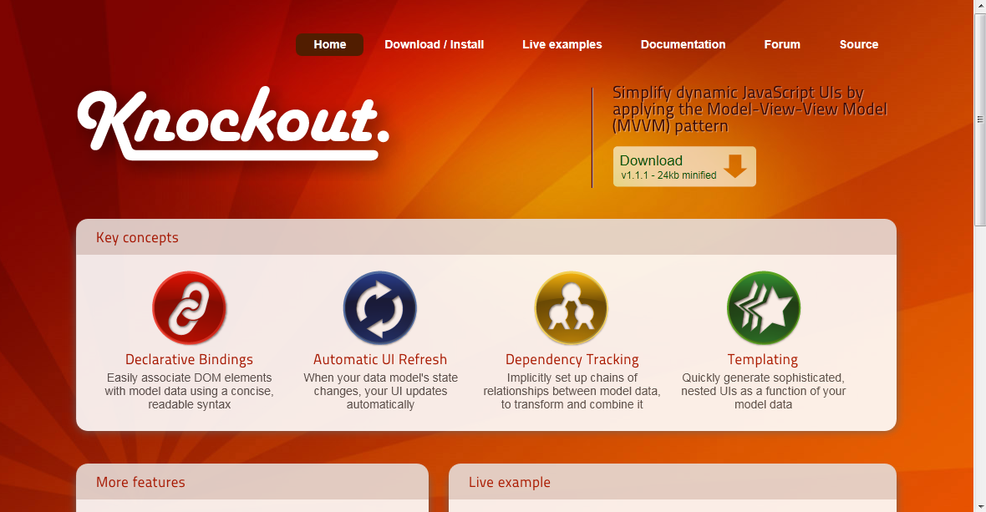
http://knockoutjs.com

Slide 8
Questions?
Your name
Your company
@YourTwitterHandle
http://yourwebsite/

